Slide 1
Wangiri Warriors: solutions & strategies for fighting call back fraud
Moderator: Dan Baker, Research Director, TRI & Editor, Black Swan Telecom Journal
Table of Contents

Slide 2
NHK's Annual Taiga Drama
 | An epic, year-long TV drama produced by NHK each year. Once a week a new episode is broadcast — 33 hours+ of film production for each Drama. Focus of 2020 Drama is the life of 16th century samurai general, Mitsuhide Akechi.
Table of Contents

Slide 3
The Tremendous Expense of the Samurai Drama
Sixty famous actors, and hundreds of lesser-known actors and extras. Realistic sets, costumes, stellar photography. Battle scenes with lots of horses! Purpose: to preserve the best of Japanese culture. To teach the lessons of human history
Table of Contents

Slide 4
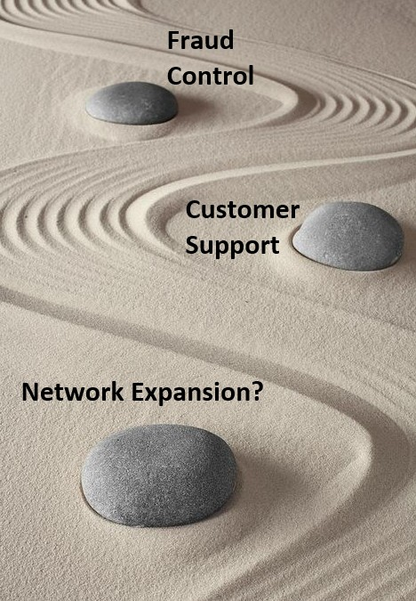
Why Invest Heavily in Telecom Fraud Control?
Isn‘t money better spent on networks and customer support?
No, ensuring a high quality of service is of great value, but it’s often not fully appreciated.
Voice/SMS fraud damages the telecom voice brand and its revenue.
Fraud control guards the voice telephony brand.
Table of Contents

Slide 5
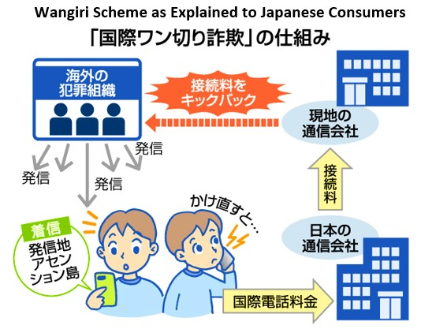
What is Wangiri Fraud?
Most common form is the “One Ring and Hang Up” invite to call an International premium rate number.
More recent variation is an invitation to an enterprise call center to call back from a web form.
The common thread of Wangiri is the call back fraud.
Table of Contents

Slide 6
Colin Yates, Yates Fraud Consulting
Former head of fraud management at the Vodafone Group
Colin is now an independent global fraud consultant operating out of New Zealand.
Also offers an International Premium Rate Number (IPRN) database (discussed in this webinar).
Table of Contents

Slide 7
Regions of the World Where Wangiri is a Threat
Colin analyzes the IPRNs advertised across the world. Wangiri affects operators everywhere. Countries of termination formerly were only high-rate destinations. Now lower-rate terminations are also offered. Hard to determine exactly which countries are being targeted. However, second hand information suggests Africa is being hit the most by Wangiri.
Table of Contents

Slide 8
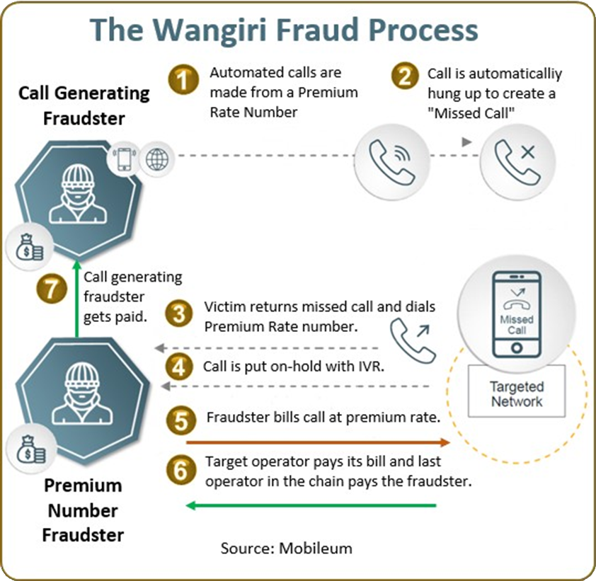
How Fraudsters Coordinate Wangiri Fraud
Fraudsters need infrastructure to send thousands of short ring calls
They also spoof the CLI number.
Coordinate with IPRN Number Providers to get a range of IPRNs to call.
Despite CSP warnings, about 10% of customers will return a Wangiri call.
The IPRN database is ideal for spotting and blocking IPRN numbers being called.
Table of Contents

Slide 9
A Connotation of Wangiri in Japanese
Wangiri in Japanese means “one ring” (then hang up the phone).
But the word “giri” also has the connotation of an obligation.
Table of Contents

Slide 10
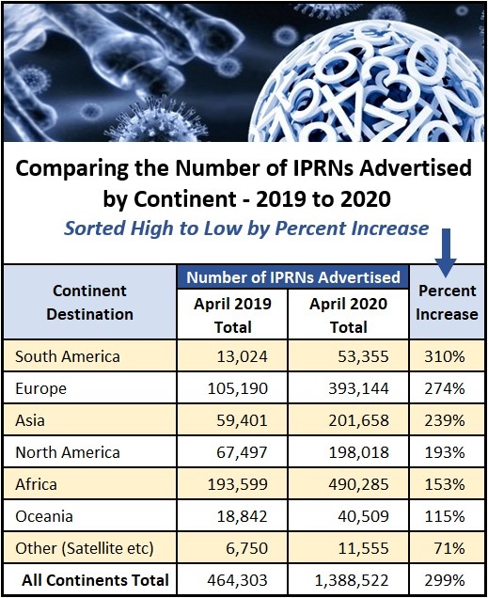
IPRN Numbers: Growth & Regional Trends
Huge 200% increase in IPRN numbers.
1.6 million IPRN numbers are now being advertised.
The African continent had biggest increase — now 42% of IPRNs.
Europe at 23% of IPRNs is surprisingly high.
Highest percent increase is South America (300%)
Lowest increase is Pacific Islands (Oceania)
Fraudsters are making a tradeoff: Use lower-rate IPRNs, but hope to evade detection longer.
Table of Contents

Slide 11
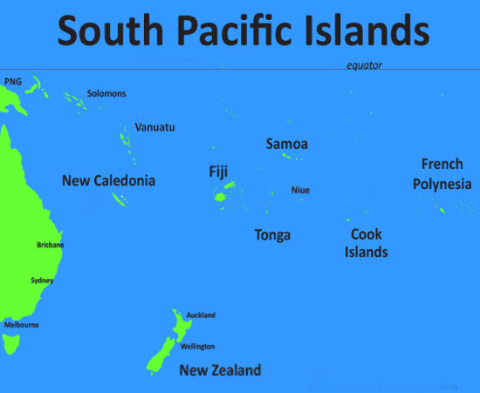
Pacific Islands: Less of a Fraud Target
Oceania includes Pacific Islands, Australia, and New Zealand.
Colin has been consulting to the Pacific Islands.
Families on the Islands are highly reliant on telecom.
The Coronavirus has halted travel between Islands.
Table of Contents

Slide 12
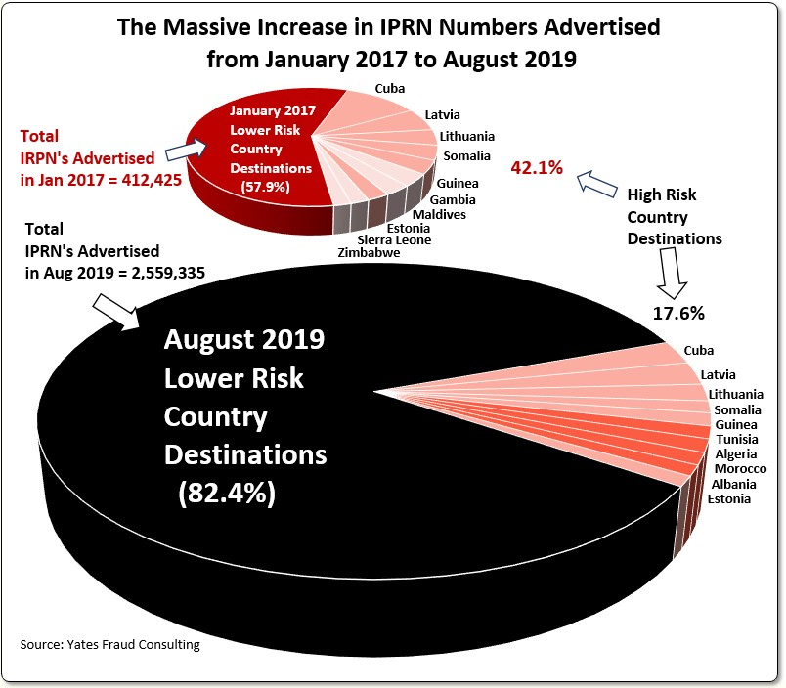
Why the Huge IPRN Volume Spike?
The strategy of simply blocking countries no longer works.
Fraudsters simply move to ranges not blocked.
In April 2020, 54% of the numbers advertised were new numbers
Colin assumed the Coronavirus was the reason for big increase, but no evidence to support that idea.
NOTE: Chart above shows the trend toward a higher percentage of IPRNs in lower risk country destinations.
Table of Contents

Slide 13
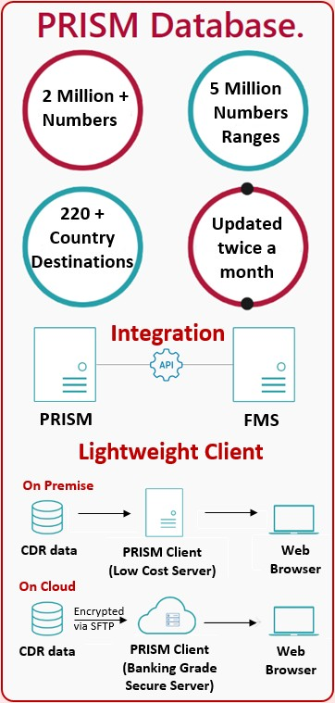
PRISM, the IPRN Database
Monitors all the providers of IPRN numbers.
Every two weeks, the numbers are updated.
It’s a hot list of fraud numbers likely to be used.
Lists published by GSMA and others are blacklists: previously used fraud numbers.
However, numbers never used before are the most attractive to fraudsters.
iconectiv publishes its own global allocated numbers database: uses PRISM as its IPRN numbers source.
PRISM has 70 customers around the world.
Another list Colin publishes is one on Mobile Station Roaming Numbers (MSRNs).
Fraudsters are hijacking these MSRNs. 54,000 MSRNs are in the database.
Table of Contents

Slide 14
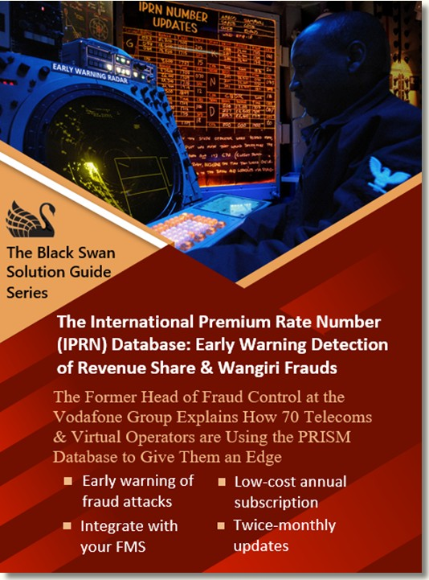
Solution Guide on PRISM
PRISM is the focus of a 14-page Guide with Colin Yates as commentator.
Available for free download.
The IPRN Database and its Use in IRSF & Wangiri Fraud Control
Table of Contents

Slide 15
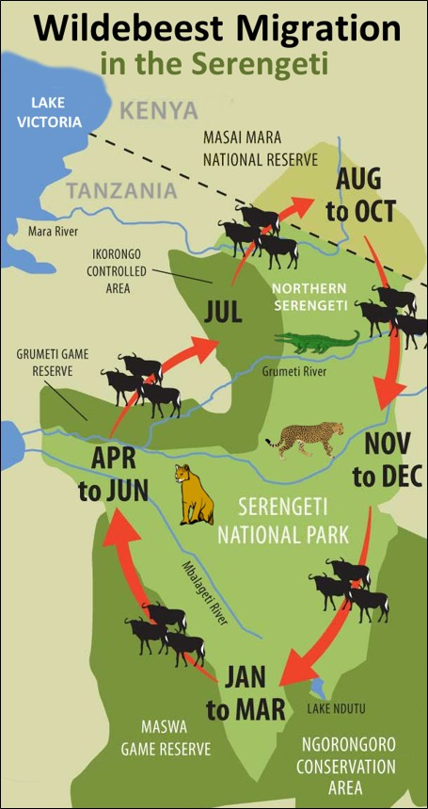
Fraudsters are like Predators on the Serengeti
Fraud control people should assume they will be attacked, sooner or later.
Plenty of resources are available today to stay current on fraud measures and solutions.
Fraudsters recognize those CSPs who are not prepared, and attack them.
The constantly look for the weakest link.
Those not prepared will suffer the losses.
Related Black Swan interview with Colin: How IRSF Predators are Evolving their Fraud Attacks on the Weak and Unprotected of the Telecom Serengeti.
Table of Contents

Slide 16
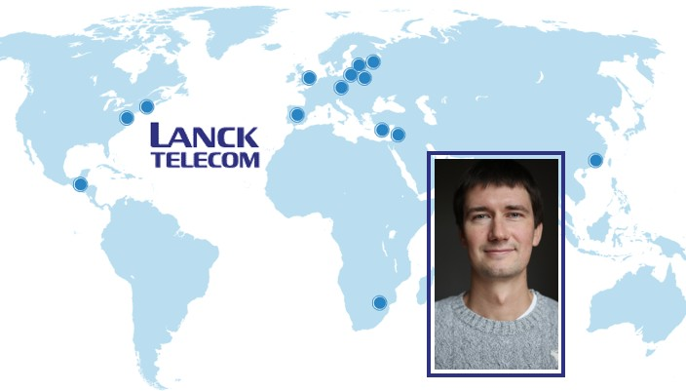
Lanck Telecom
Lanck is a Top 25 Global Voice Wholesaler carrying 3 billion voice minutes a year for its international partners.
Lanck provides an FMS platform for its partners affecting enterprise call centers and user authentication services.
Igor Skutsenya is Business Development Manager for VAS & FM- VAS Solutions at Lanck.
Lanck’s employees often work remotely, so they were ready in mid-March when the Coronavirus epidemic hit.
Lanck has detected a decrease in Roaming Traffic over the past few months since global travel has been restricted by the Coronavirus.
Table of Contents

Slide 17
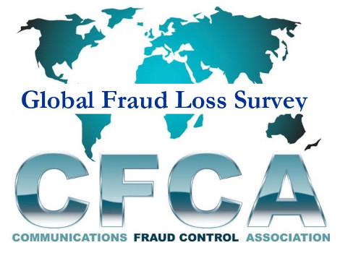
Size of the Wangiri Threat
The CFCA estimates Wangiri fraud costs communications providers $1.8 billion per year.
Lanck is in direct contact with retail telecom partners who are very concerned.
Table of Contents

Slide 18
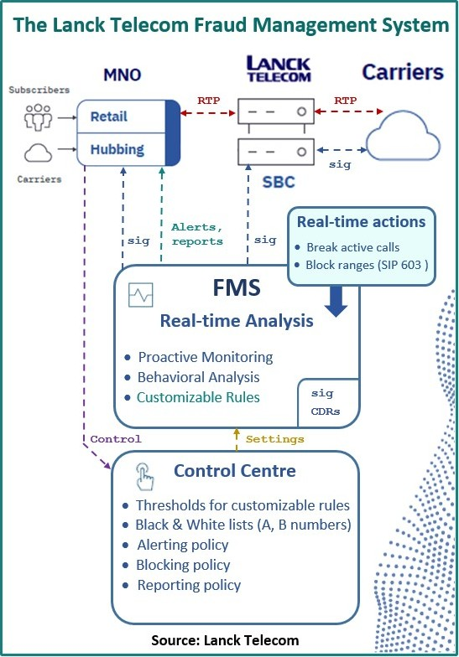
How Lanck Detects Wangiri
Hundreds of wholesale and retail operators connect with Lanck.
As a wholesaler, we see Wangiri attacks in both its inbound & outbound phases.
With Inbound Wangiri attacks, Lanck’s FMS is very effective at stopping it.
Machine Learning is the primary tool; secondarily Lanck uses a database of fraudulent numbers.
Real-time blocking is achieved. Analytics prevents the end user from receiving a Wangiri call.
Outbound Wangiri calls are also discovered. The call is either blocked, or a warning IVR message is heard by the end user caller.
Table of Contents

Slide 19
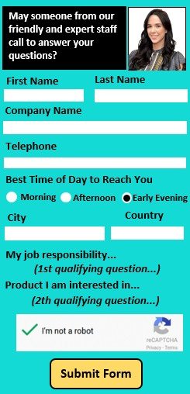
How Wangiri 2.0 was Discovered
Lanck’s FMS created a profile for standard Wangiri calls that largely target consumers as its victims.
Wangiri 2.0 is different: it attacks enterprises and utilizes one-time password delivery via voice calls.
Lanck quickly discovered it was fraud. Understanding the fraud scheme however required more analysis and time.
Pictured at right is an example of an on-line form of a business offering to make an international phone call.
Table of Contents

Slide 20
Enterprises at Risk from Wangiri 2.0
Enterprises at risk are those who do a large volume of outbound international voice traffic Global companies with large call centers are at the greatest risk. Another business at risk: those that deliver One-Time Passwords (OTP) by voice message.
Table of Contents

Slide 21
How Lanck Blocks Wangiri 2.0
Lanck’s FMS tool successfully detects and blocks Wangiri 2.0 attacks.
The inbound attack cannot be discovered because it happens on-line via the internet.
On the outbound calls, the Lanck FMS recognizes the Wangiri 2.0 numbers.
Calls are blocked or a warning message is sent to an IVR machine warning the phone user of danger.
The majority of Lanck’s partners currently have Wangiri 2.0 protection.
Table of Contents

Slide 22
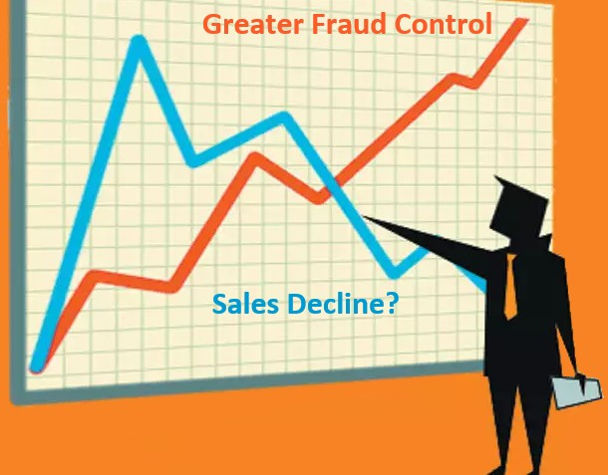
Best Practice Advice for Blocking Wangiri 2.0
Very hard to give general advice.
Enterprises operate quite differently in their outbound call centers doing international marketing & sales.
The enterprise relies heavily on outbound sales calls: that conflicts with the need to better manage their fraud risks.
Table of Contents

Slide 23
Stopping Wangiri 2.0: FMS Features to Look For
An advanced FMS is required — one that can discover attacks as soon as possible.
Lanck recommends machine learning, advanced analytics, tight traffic monitoring, and keeping lists of dangerous numbers always updated.
Table of Contents

Slide 24
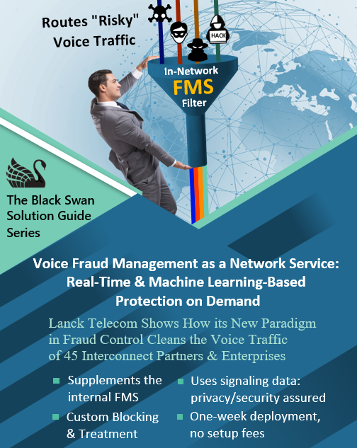
Solution Guide on Lanck FMS
Guide just released:
Voice Management as a Network Service: Real-Time & Machine Learning-Based Protection on Demand
Plus, some Black Swan interview stories with Lanck: Lanck Telecom Raises Fraud Alarm for International Brands, Enterprise Call Centers & Carriers: Beware of Wangiri 2.0.
A&B Handshake: A Simple Way to Control Voice Fraud via an Out-of-Band Connection between A & B Operators.
Table of Contents

Slide 25
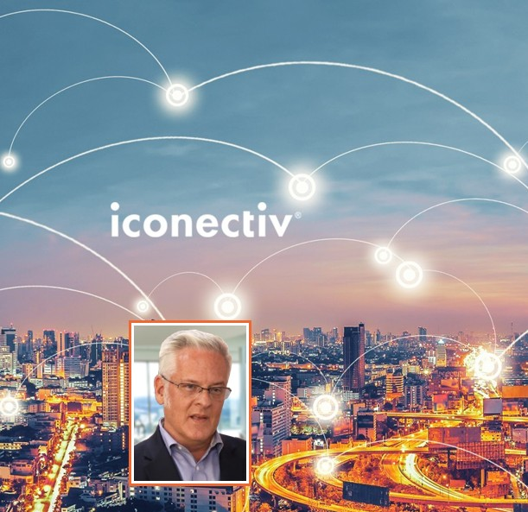
iconectiv & TruNumber Protect
Expert: John Haraburda, Principal Solution Engineer, iconectiv TruNumber Protect
TruNumber Protect is a global cloud database of allocated phone numbers.
It’s an authoritative source showing active/inactive status of phone numbers.
John travels the globe and looks forward to traveling widely again soon.
Two favorite countries to visit are Brazil and South Africa.
Table of Contents

Slide 26
A Global Numbers Database vs. a Blacklist
TruNumber Protect has 50 clients at large and mid-sized voice providers.
It is used to help operators manage their traffic and fraud.
The value comes from the ability to mitigate voice fraud before the call leaves the network.
Blacklists come from a historical vision of fraud.
Often you see blacklists contributed by very few operators within a membership.
Actual reporting of the fraud numbers to the blacklist is usually not immediate.
But TruNumber Protect knows a particular number (in a particular country) is an unallocated number so it’s fraud risk is already known.
Table of Contents

Slide 27
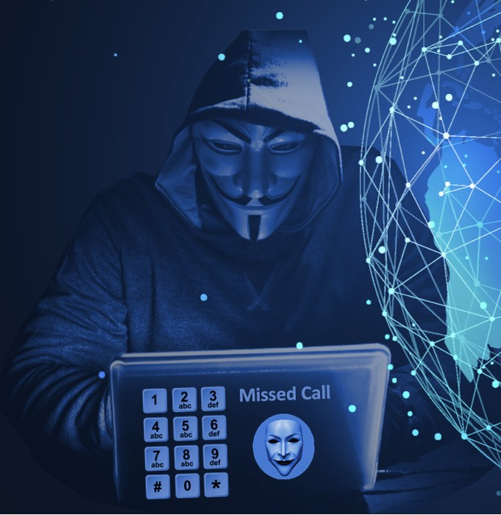
Using Cloud Database to Stop Wangiri Fraud
Blocking Wangiri is usually a matter of checking the outgoing call the consumer makes. But with TruNumber Protect, you are able to look at the Wangiri fraud invitation call to the consumer. Then, recognizing the number is in an unallocated range, the operator can stop the incoming fraud (one-ring) invitation call from ever reaching the consumer.
Table of Contents

Slide 28
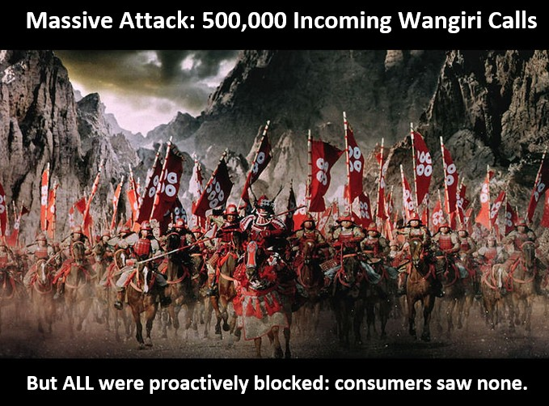
Use Case for Wangiri Fraud Proactive Blocking
A European operator faced several hundred thousand dollars of fraud per month.
After implementing our solution, they were able to prevent calls from ever reaching the consumer.
A major operator in the US faced a Wangiri attack with 500,000 call attempts, but none ever got to the consumer.
Table of Contents

Slide 29
Making the Leap to Proactive
TruNumber Protect is not as cheap as FREE: many operators believe they can get by with free blacklists.
However operators who use these reactive fraud control methods are still hit by fraud.
Then, when they hit a fraud loss tipping point they say: “Why are we still reacting to fraud when we can proactively block it.”
iconectiv does a free analysis of operator traffic to see what the potential value of TruNumber Protect would be.
Operators often find the ROI is only one to three months for the fraud use case alone.
TruNumber Protect is also used for many other use cases beyond fraud protection, such as: 1) general network routing for voice and SMS traffic; and 2) business & data analysis of traffic with CDR enrichment, etc.
These added cases make the ROI even shorter.
Reactive
Proactive
Table of Contents

Slide 30
Leveraging the Database in Billing, AI & Business Analytics
City and Country information can be added to customer bills
In AI and data analytics, the city and country information is quite valuable.
Example: Analysis can be done, say, on traffic volumes on Fridays to and from the Middle East.
Such traffic detail can be also invaluable in machine learning and AI applications.
Table of Contents

Slide 31
Managing Fraud Blocking Rules
The cloud makes rule maintenance easier.
TruNumber Protect customers define where and how the information is used.
We recommend a multi-tiered strategy that looks at routing tables, blocking numbers on the switch, interface with RA and/or fraud system, and business analytics.
When the TruNumber Protect data set triggers something, action can be set at a very low threshold, such as a single phone call.
You can then say, “I’m comfortable having these types of ranges actively blocked on the network”
Exception processing is also integral.
Unique file import formats for each system (FMS, business analysis, etc.) are also supported.
Table of Contents

Slide 32
Fraud Analyst Productivity from Integration
The idea is to integrate with the functionality that exists in each operator’s FMSs and network devices/elements.
FMS already can ingest datasets to run alerts against.
Likewise, switches are comfortable using blacklists and exception lists.
Integration enables the FMS to be a more efficient tool.
By proactively removing unallocated traffic, it not longer needs to show up as an alert in the FMS.
So now, rather than 1,000 alerts, the FMS is dealing with maybe 250 alerts.
With analyst time freed up, fraud cases can be investigated that would normally fall below the radar.
Fraud analysts can now rise above the “noise” and focus on a far reduced number of key alerts — they become more productive.
Table of Contents

Slide 33
Proactive Blocking feeds valuable intelligence to the FMS
Proactive blocking can also catalyze the FMS to notify a specific customer about potential fraud.
Example: When a mobile handset and its SIM card is stolen, the fraudulent user tries to pump revenue share fraud through that handset, but now the first outbound test call will raise an alert.
So proactive blocking enables the fraud analyst staff to work on higher value fraud cases.
Table of Contents

Slide 34
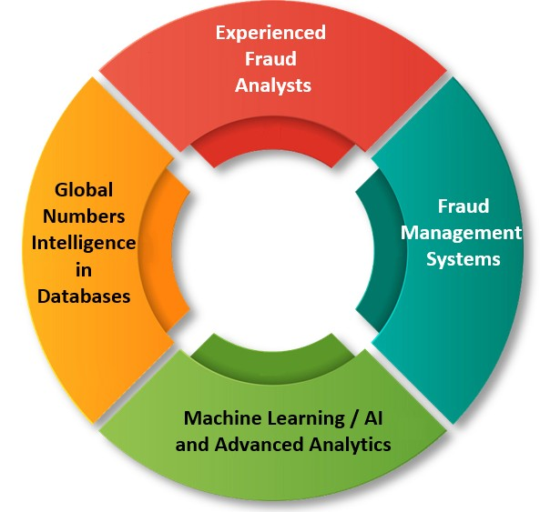
Coordinating the pillars of fraud control success
Traditionally, fraud control has three pillars: experienced fraud analysts, databases, and the FMS.
But a fourth pillar is arriving: greater use of AI/Machine Learning and other advanced analytics.
All pillars must work together to gain the maximum benefit.
A cloud database of global phone numbers is ADDITIVE to the FMS and should also be additive to advanced Machine Learning/AI and analytics.
The key is not to waste analyst time tracking attacks to unallocated numbers. They can be proactively blocked.
BONUS: More focus can be put on customer satisfaction, improving profitability of routes — and these are things a fraud management system will want to look into.
Table of Contents

Slide 35
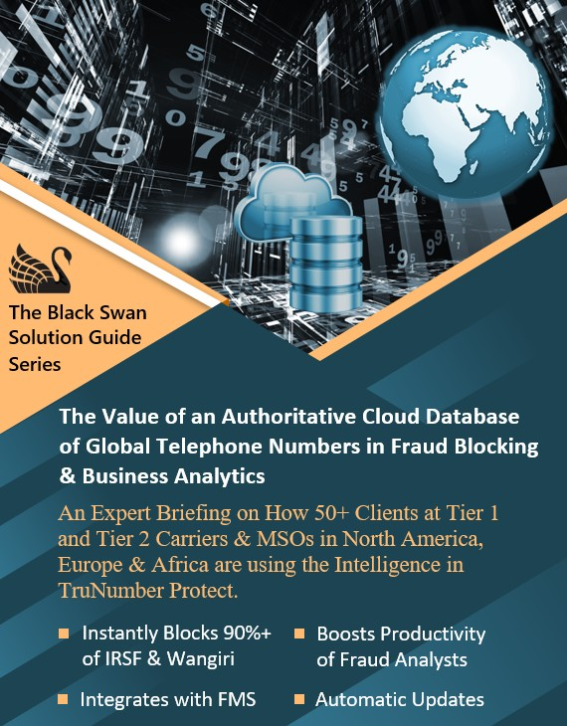
Black Swan Solution Guide on Cloud Database
A more comprehensive discussion by John Haraburda on TruNumber Protect is in a new Black Swan Solution Guide:
The Value of an Authoritative Cloud Database of Global Telephone Numbers in Fraud Blocking & Business Analytics
Table of Contents

Slide 36
Oculeus Introduction
Expert: Arnd Baranowski, CEO
Oculeus is headquartered in Frankfurt.
Well-prepared for Coronavirus — international workers are used to working remotely.
Across all telecom spheres, new business is in suspense mode.
Fortunately Oculeus continues to do well serving its existing customers.
Table of Contents

Slide 37
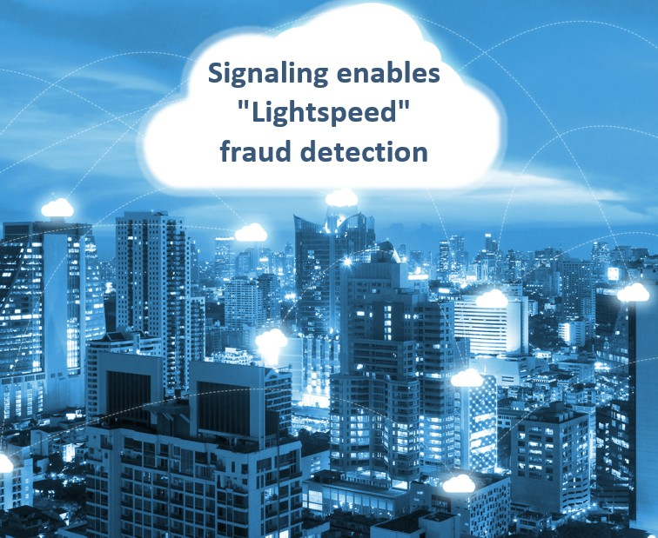
The Value of Signaling in Fraud Detection
Oculeus is a pioneer in the use of signaling to detect IRSF & Wangiri.
Signaling allows us to get to “light speed” fast.
Within milliseconds we can get time sequences and get really close to customers using telephony.
Yet the solution preserves privacy because only the signaling of anonymous users layer is seen by the Oculeus system.
The same CDR info is available at call start or in the first milliseconds.
Table of Contents

Slide 38
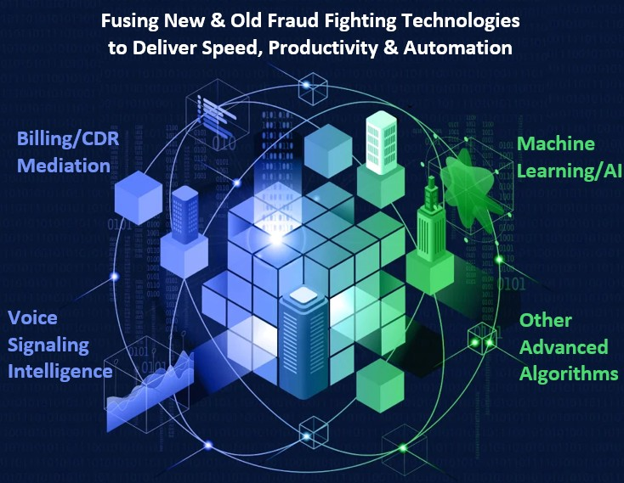
Oculeus Fuses Old & New Software Achievements
Certain companies focus on Machine Learning/AI ignoring what’s already there. Others continue with their existing systems.
Actually, all the systems on the market incorporate some form of artificial intelligence — that’s what automation is about.
We are focused on combining old and new technologies to achieve the best results.
So we don‘t need to abandon existing achievements on the way to only machine learning.
We think this is the most flexible way to configure systems as desired.
Table of Contents

Slide 39
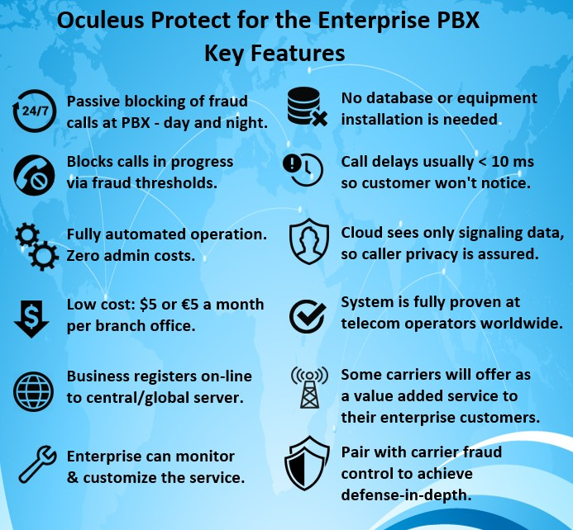
Stopping Wangiri at the Enterprise PBX
In countries like Germany & USA the enterprise is ultimately responsible for taking Wangiri and IRSF losses.
Oculeus now intercepts signaling direct from the enterprise PBXs where the fraud originates.
This is a core technology developed over several years in our Oculeus Protect customer-centric system.
Checking every call for fraud within 10 -- 100 milliseconds, it figures out if the call was 1) made by the PBX owner; 2) injected by a fraudster; or 3) the result of a Wangiri attack.
The phone caller will not even know the check is being performed.
The decision to block the call is made by the system incorporating AI, machine learning, and other advanced algorithms.
Table of Contents

Slide 40
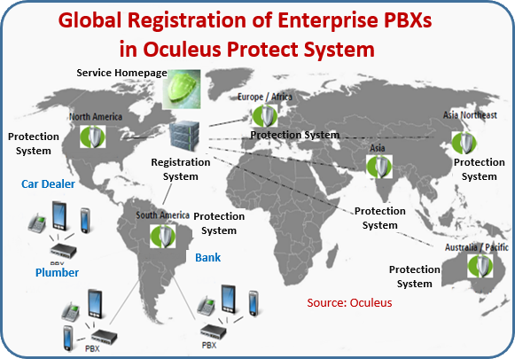
PBX Fraud Monitoring Serves as Double Layer Protection
Carriers can offer PBX protection as a paid-for value-added service to their customers.
Service is offered at a low, no-brainer fee to customer.
The service is offered as additional insurance.
The fees vary from $5/month for a small firm, $25 for a medium-sized firm, and $50 to $100 for a large enterprise.
Fraud can be detected and action taken in the Enterprise Network (PBX) or Carrier Network.
As long as you monitor the Signaling Flow and stay ahead of Call Routing, you can prevent fraud from happening.
Table of Contents

Slide 41
The Unique Operational Background of Oculeus
Oculeus came into the market providing software to support Carrier Operations, particularly Wholesale/ Interconnect.
Preventative Fraud Control is integral to the Oculeus solution, whereas an FMS implies managing fraud that has already occurred.
Another philosophy of ours is to have the system run as Autonomous as possible.
We’ve been in the business for 8 Years, and our approach works well.
Table of Contents

Slide 42
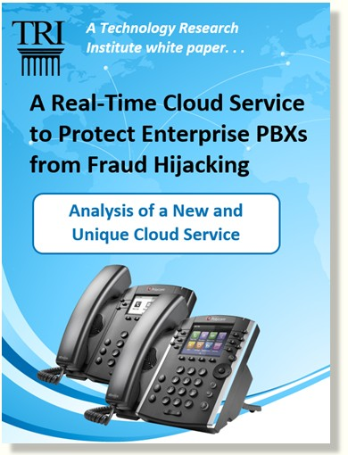
White Paper on Enterprise PBX Fraud Protection
Download the Paper here:
White Paper: A Real-Time Cloud Service to Protect the Enterprise PBX from IRSF Fraud
Table of Contents

Slide 43
Himeji Castle
One of the biggest and most beautiful of Japanese castles (90 km west of Osaka)
First built in the 1300s
Then rebuilt after General Tokugawa ended Japanese civil war in 1615.
The peace lasted for 2.5 centuries.
Table of Contents

Slide 44
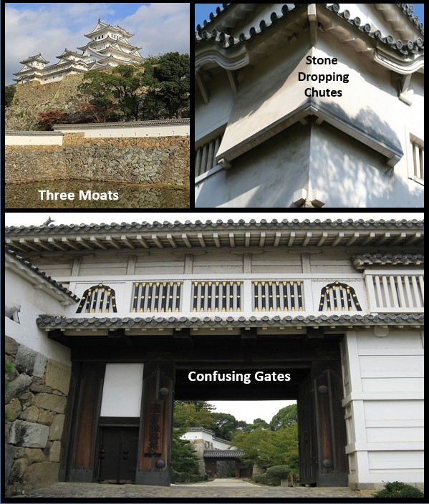
Himeji Castle's Defenses-in-Depth
Three water moats (22 meters wide) surround the castle.
Chutes under windows allow defender to drop stones on attackers climbing walls.
Most innovative are the Gates of the Castle that disorient attackers: 1) Entrance ways often go the opposite direction; 2) Narrow and steep passageways slow down attackers; and, 3) Attackers lack a detailed map of Castle defenses.
Table of Contents

Slide 45
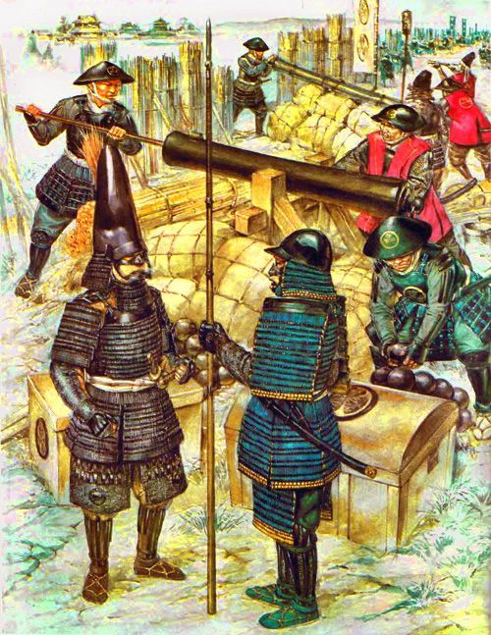
Why did Tokugawa have Himeji Rebuilt?
Tokugawa himself rose to power by destroying Osaka Castle with cannons.
He knew that Castles had outlived their usefulness in the age of artillery.
A Theory: Perhaps Tokugawa wanted to keep his samurai occupied in construction work. In that way, they would have less time and energy to think about breaking the peace.
Table of Contents

Slide 46
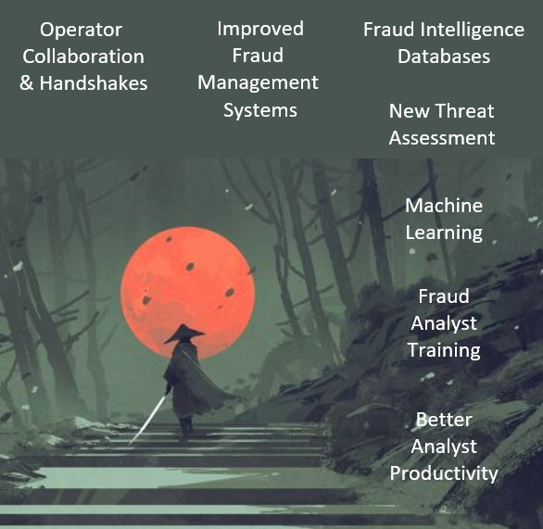
How Good are Your Company's Fraud Defenses?
Are you spending too much time rebuilding old defensive systems that have outlived their usefulness?
Are you staying on top of ever-changing threats?
Do you re-think your defenses as new innovations and fraud-fighting techniques emerge?
Table of Contents

Slide 47
Additional Resources
Webinar
Link to the Speaker Bios
Download Podcast (MP3)
Download PowerPoint (PPTX)
Link to YouTube channel
Research & Reports
TRI’s Research Report page
Black Swan Telecom Journal homepage (includes Solution Guide links)
Table of Contents

Slide 48
Wangiri Warriors Webinar -- Table of Contents (Linked)
Dan Baker, Black Swan Telecom Journal (4:00 minutes)
1. Wangiri Warriors Introduction 2. NHK's Annual Taiga Drama 3. The Big Expense of Samurai Dramas 4. Why Spend Big on Fraud Control? 5. What is Wangiri Fraud?
Colin Yates, Yates Fraud Consulting (13:45)
6. Introducing Yates Consulting 7. The Worldwide Wangiri Threat 8. How Fraudsters Coordinate Wangiri 9. A Connotation of “Wangiri” 10. IPRN Number Trends 11. Pacific Islands & Fraud 12. Huge IPRN Volume Spike 13. PRISM, the IPRN Database 14. Solution Guide on PRISM 15. Fraudsters as Predators
Igor Skutsenya, Lanck Telecom (8:40) 16. Lanck Telecom Introduction 17. The Wangiri Threat 18. How Lanck Detects Wangiri 19. Discovery of Wangiri 2.0 20. Enterprises at Risk in Wangiri 2.0 21. How Lanck Blocks Wangiri 2.0 22. Best Practice Advice? 23. FMS Features to Look For 24. Solution Guide on Lanck FMS
John Haraburda, iconectiv (16:12)
25. iconectiv & TruNumber Protect 26. Global Numbers Database vs. Blacklist 27. Using Cloud Database to Stop Wangiri 28. Use Case for Proactive Blocking 29. Making the Leap to Proactive 30. Leveraging Other Use Cases 31. Managing Fraud Blocking Rules 32. Fraud Analyst Productivity 33. Feeding Intelligence to the FMS 34 The Pillars of Fraud Control Success 35. Solution Guide on TruNumber Protect
Arnd Baranowski, Oculeus (10:01)
36. Oculeus Introduction 37. Value of Signaling in Fraud Control 38. Fusing Old & New Software 39. Stopping Wangiri at the PBX 40. PBX Serves as Double Layer Protection 41. Oculeus Operational Background 42. White Paper on Oculeus Protect
Dan Baker, Final Perspective (2:01)
43. Himeji Castle 44. Himeji Castle's Defenses-in-Depth 45. Why did Tokugawa Rebuild Himeji? 46. How Good are Your Company's Fraud Defenses? 47. Additional Resources

